Slide 1
COUNCILOR MEJIA X CITY SERVICES PROJECT
Team 3
Derek Dumouchel
Zihao Shen
Tian Tan
Lu Yao

Slide 2
COUNCILOR MEJIA X CITY SERVICES Client Partner: Sandra Saavedra and Councilor Mejia Project Manager: Sophia Marian Sena Technical Engineer: Aidan Gomez
Team 3
Derek Dumouchel
Zihao Shen
Tian Tan
Lu Yao
Motivation
To ensure that the city of Boston equitably distributed relief funds across demographics (race, ethnicity, income, etc.) during Covid-19 Pandemic
Goal
Analyze business relief datasets along with available census data to determine the outreach and adequacy of the aid.
Background
Covid-19 had devastating effects on the economy, severely hindering business revenue and growth. It is believed that it disproportionately affected lower income residents and businesses.

Slide 3
MID-SEMESTER STATUS
Accomplishments
Evaluation of race composition and population density.
Dispersity of funds across neighborhoods
Division of Labor
Weekly meetings on Mondays to review goals and assessments.
Status updates via Slack and Google Drive on Thursdays, prior to the weekly meetings with the project lead.
Different datasets and features are reviewed and assessed by team members.
E.g., Business Funds/Licenses dataset, Census block data, Geocode Analysis
Team lead chosen with collaboration on deliverables via Google Docs.
Dataset Utilization
‘Boston Neighborhood’
‘Business Assistance Funds’
‘Boston Zoning Subdistricts’
‘Boston Census Data’
‘Active Food Establishment License’
‘Liquor License’

Slide 4
EARLY OBSERVATIONS
Results
Slides 5-8
Visualizations (put plots)
Slides 5-8
Challenges with Data
Dataset not up to date
Total funding allocation per business not provided

Slide 5
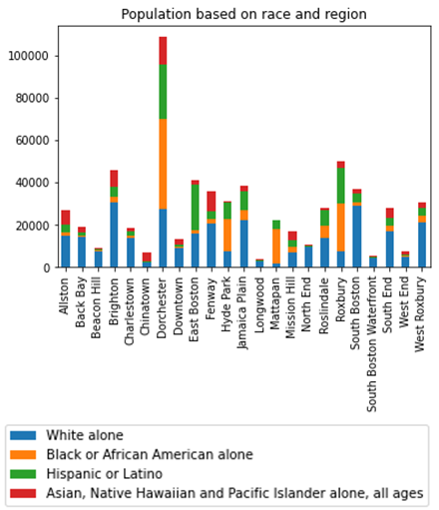
Census Analysis
Surrounding downtown(Chinatown, South End, North End, West End, Bay Village, Beacon Hill and Back Bay): Chinese and other Asian populations, African American, white.
North and east of downtown(East Boston and Charlestown): a majority of Hispanics, Brazilians.
West of downtown(Fenway Kenmore, Allston, Brighton, Longwood and Mission Hill): populated heavily by students from nearby universities. Mission Hill is an ethnically diverse neighborhood.
South of downtown(Roxbury, Jamaica Plain, Dorchester and South Boston): Dorchester is considered to be Boston's most diverse.
Roslindale: a majority-minority neighborhood.
Mattapan: mainly African Americans.
Hyde Park: mainly African Americans and Caribbean Americans
West Roxbury: mainly white.

Slide 6
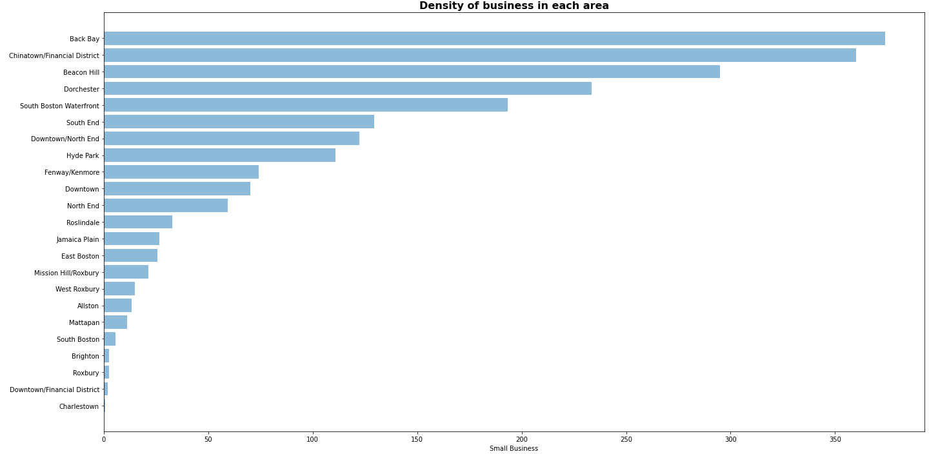
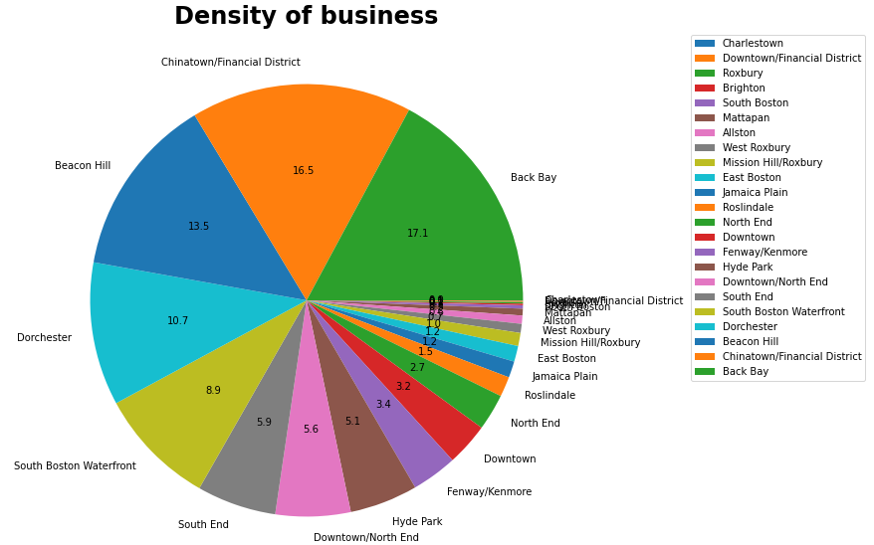
Distribution of small businesses
By combining the amount of small business and the area of each neighborhood, we can find that Back Bay and Chinatown/Financial District area have higher density of small businesses, with over 350 per mi^{^2}

Slide 7
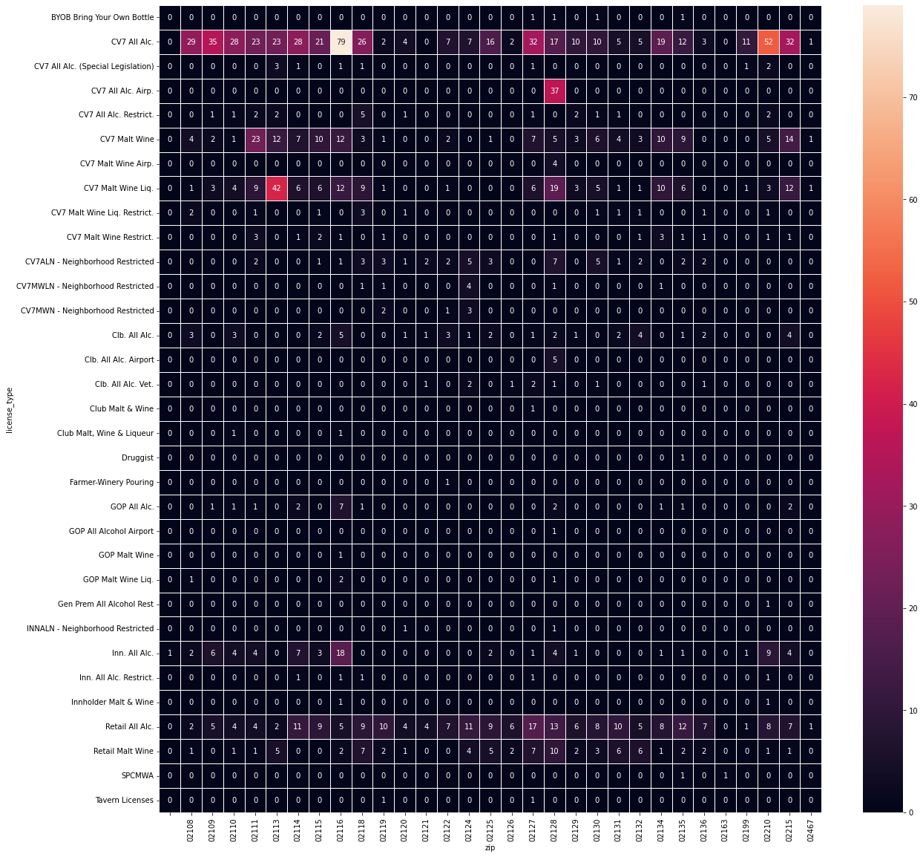
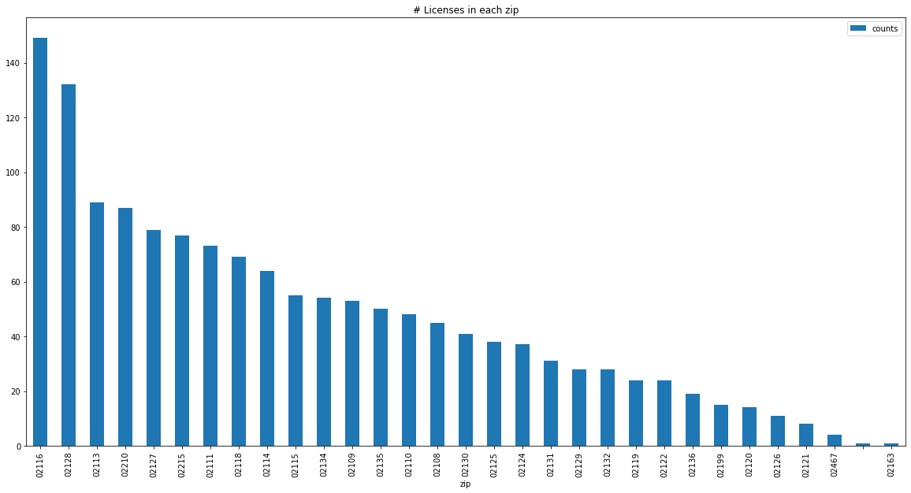
Alcohol Analysis
33 license types among 31 regions
If analyze together, generated the plot left
The license ‘CV7 All Alc.’ is usually used.
If analyze separately, generated the plot below
The zip code 02116 has most licenses.

Slide 8
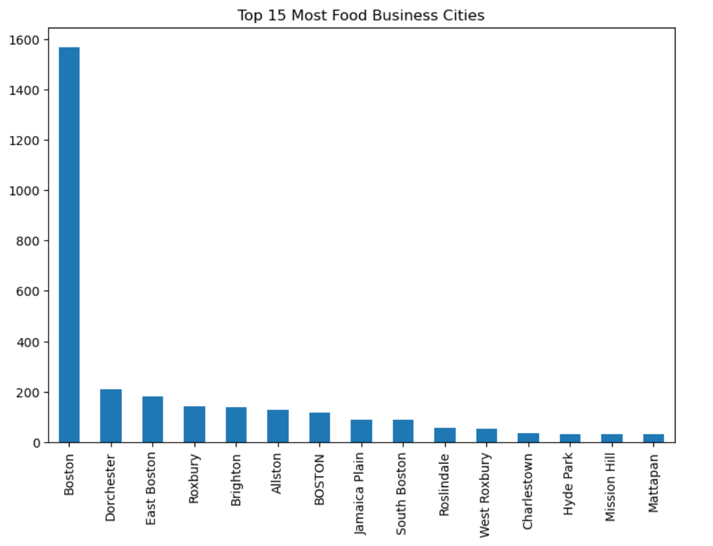
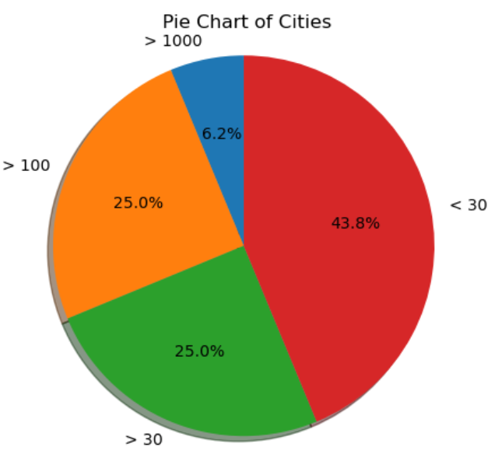
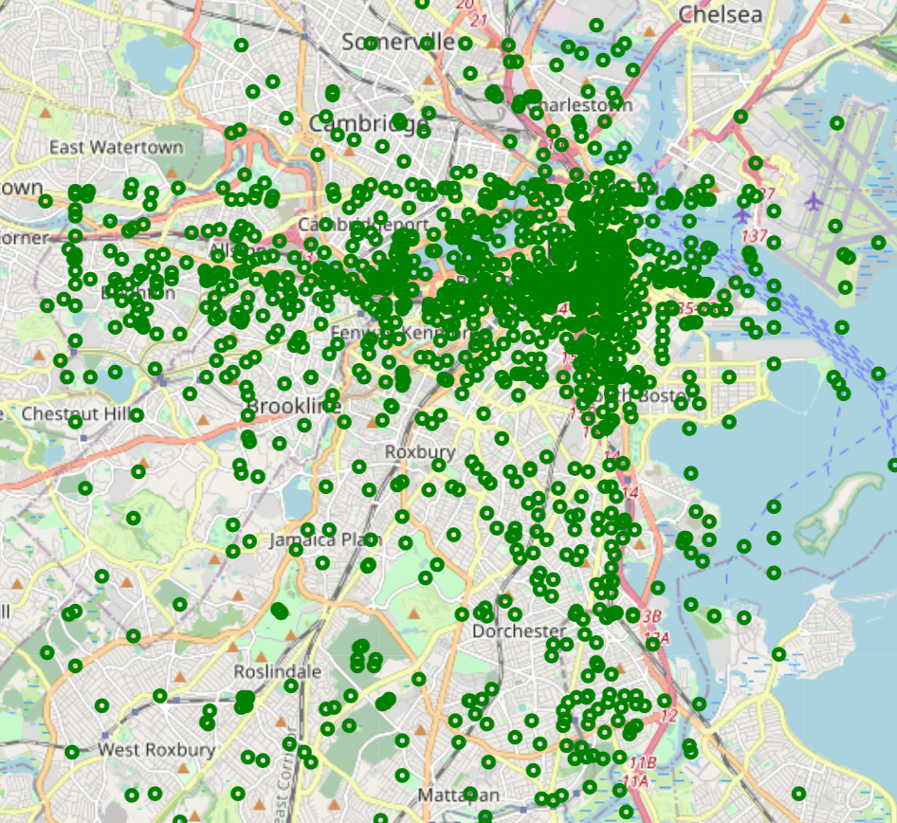
Food Analysis
Bar chart shows the number of food businesses in each city. It is very easy to find that the number of food businesses in Boston far exceeds that of other regions. In other regions, food business is more evenly distributed.
The pie chart displays the proportion of cities based on the number of food businesses. Cities with less than 30 food businesses account for 43.8% of all cities.
By marking all food businesses on the map, it shows that their distribution is scattered around the Boston city.

Slide 9
CHALLENGES AND LIMITATIONS
Challenges
Data’s categories are various, it is hard to combine together
Confused about the criteria for defining equity communities, i.e. communities where funding should be targeted to achieve the city’s equity goals.
Next Steps (early results, next steps, plans to complete project)
Do further research and data visualization
Compile fundings and answer questions

Slide 10
COUNCILOR MEJIA X CITY SERVICES PROJECT
Early Insights - Follow Up Presentation
Team 3
Derek Dumouchel - Team Lead
Zihao Shen
Tian Tan
Lu Yao

Slide 11
Early Insights Quick Recap
In the last time, we analyzed the three datasets of Business Assistance Funds, Licenses and Census in the basic project in detail.
We found that where the number of licenses and population were higher, business funds were relatively higher.
This time, we analyzed three types of data sets: Rental Assistance, Cannabis licenses data, and Capital Investments. In this way, we analyzed all available datasets provided by the base project.
At the same time, we analyzed the Main Street Business dataset that was added last Friday.
We will also present the results of our extension project.

Slide 12
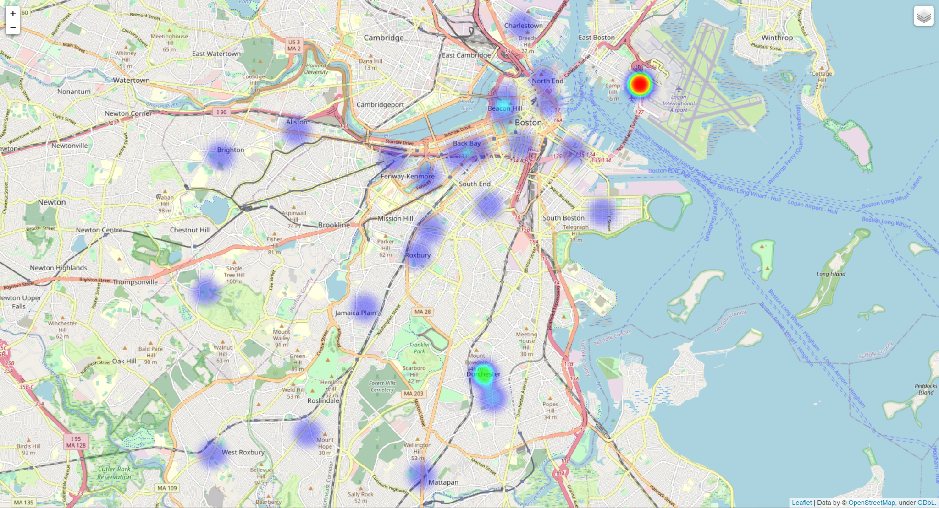
Rental Assistance Analysis
Overall
Over half of people in Roslindale, Mattapan, and Beacon Hill got $6000 RRF amount.
Beacon Hill had the highest amount of rent owing
Sum
The sum of the RRF Award Amount
and Rent Owing are highly correlated.
East Boston had the highest sum of RRF Award
and Rent Owing
And if we consider the sum of three parts
of Dorchester, it got the second highest RRF Award.

Slide 13
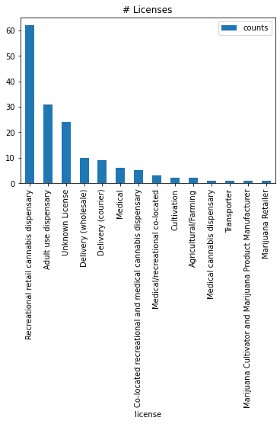
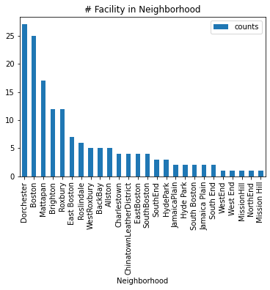
Cannabis Registry Analysis
Dorchester and Boston have the most facilities with cannabis license, then Mattapan, then Brighton and Roxbury.
There are about 15% records didn't show the type of the license.
The most commonly used license is Recreational retail cannabis dispensary, and then Adult use dispensary.

Slide 14
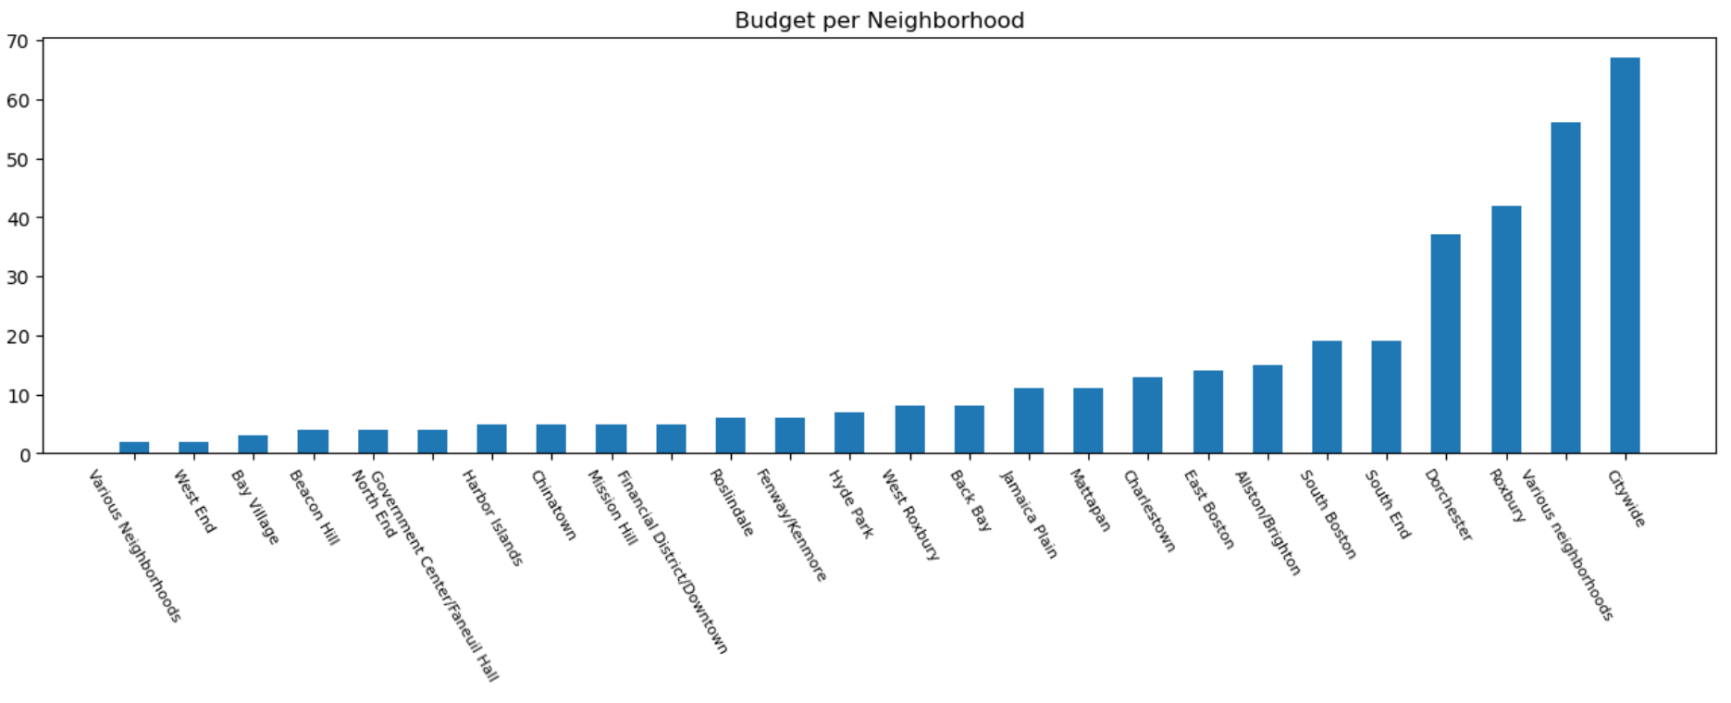
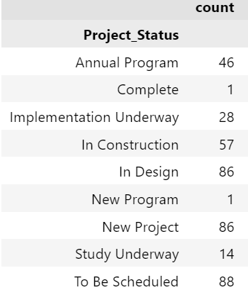
Capital Investments Dataset
We counted the budget totals for all neighborhoods. It can be found that citywide has the highest total budget.
Meanwhile, the status of all projects is also analyzed. The status of most projects are: In Design, New Project and To Be Scheduled. This can reflect the very good project vitality in Boston, which means that there are many new projects being conceived.

Slide 15
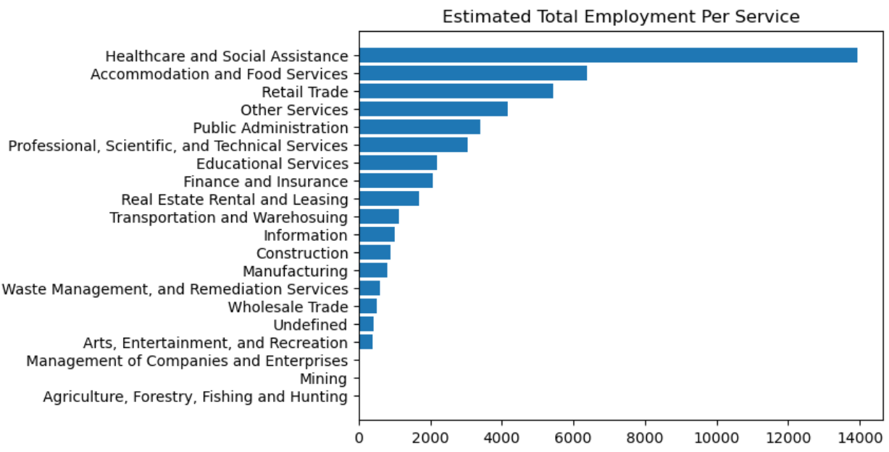
Main Street Business Dataset
We analyzed the Number of Business Services Per Main Street and Estimated Total Employment Per Service.
The chart below shows that the healthcare service requires the most employment, it is twice as much as the accommodation service. This is very logical. In the context of the pandemic, it accurately reflects the current living needs of citizens. Citizens are under increasing pressure on medical care and accommodation.

Slide 16
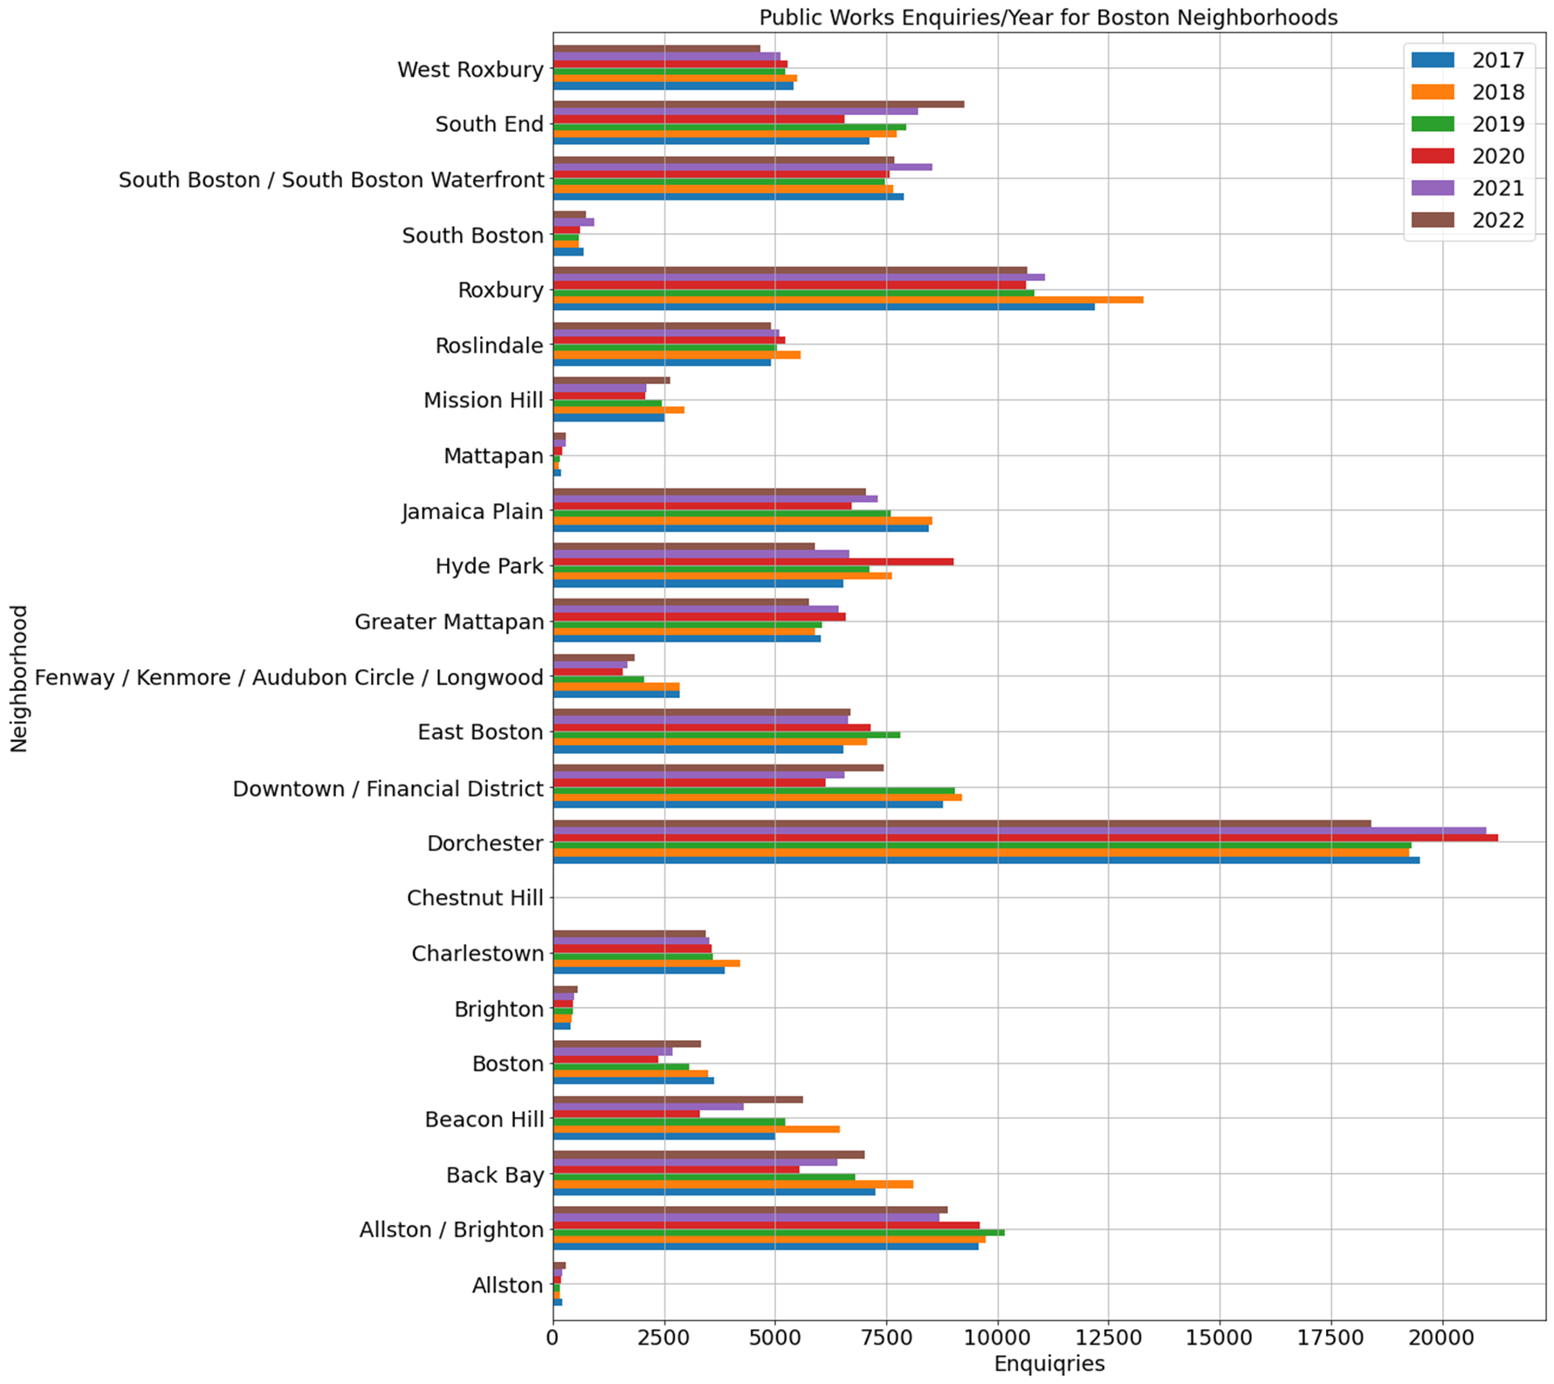
Boston 311 Extension Project Overview
Boston 311: Residents request city services for a variety of topics
Explore how service requests varied across different neighborhoods/demographics of Boston area.
Explore which types of requests are more likely to be closed quicker and if this varied by Area
Determine how the Covid-19 pandemic request types and how it affected response times.
Analyzed Data from 2017-Present
*Closed Requests Shown

Slide 17
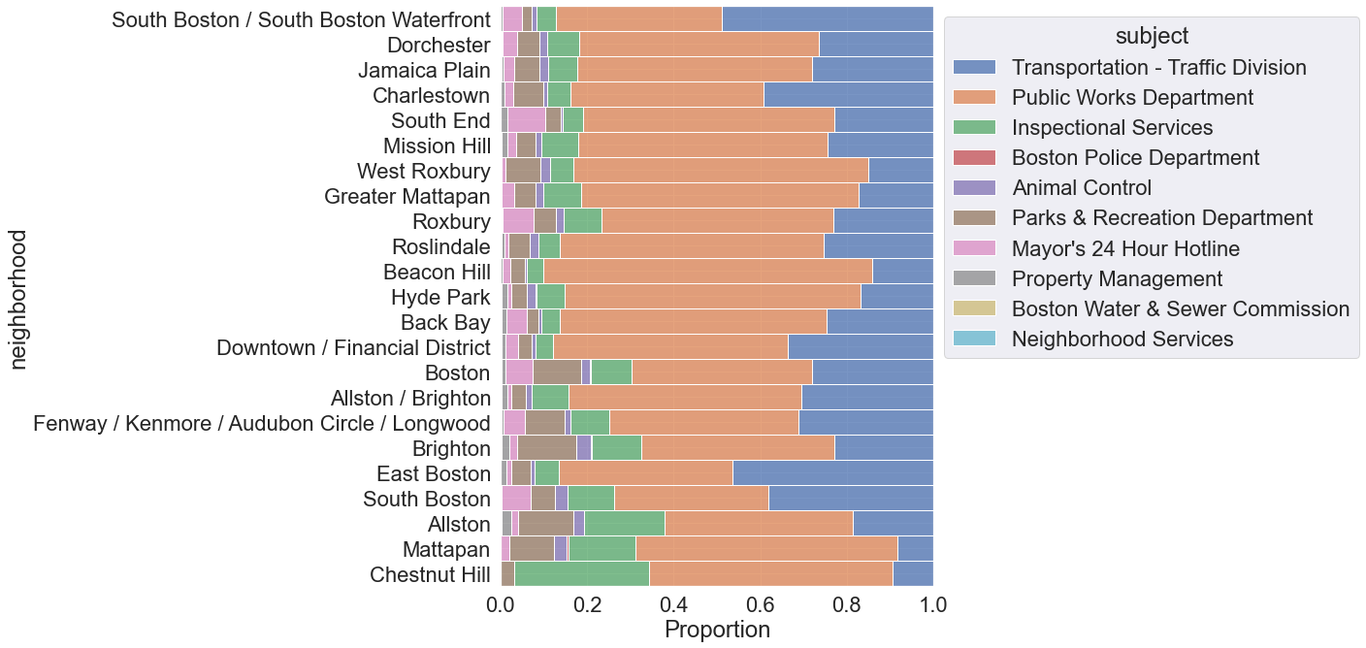
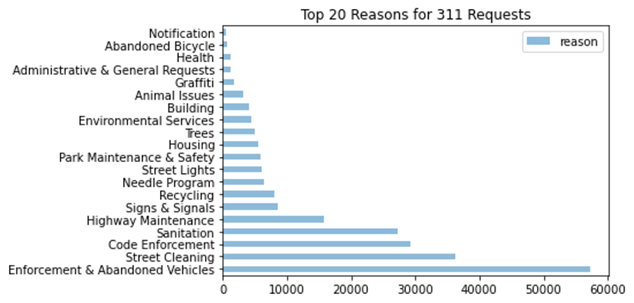
Boston 311 Extension Project
Enquiries Breakdown
2022 Enquiries Breakdown By Neighborhood
2022 Enquiries Occurrences
Generally, largest number of Enquiries within Transportation and Public Works Departments
The top 4-5 enquiries make the majority of request
Enforcement & Abandoned Vehicles
Street Cleaning
Code Enforcement
Sanitation
Highway Maintenance

Slide 18
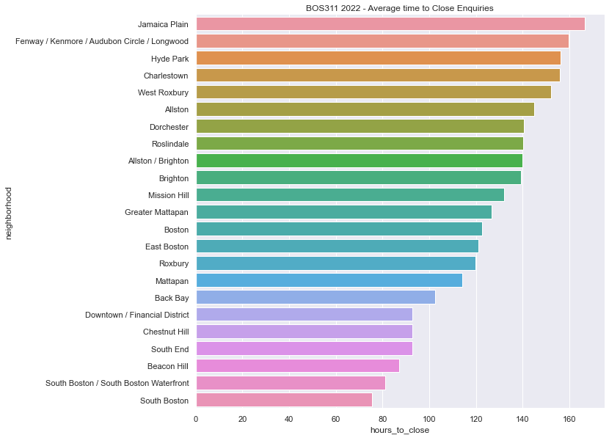
Boston 311 Extension Project Time to Close Enquiries

Slide 19
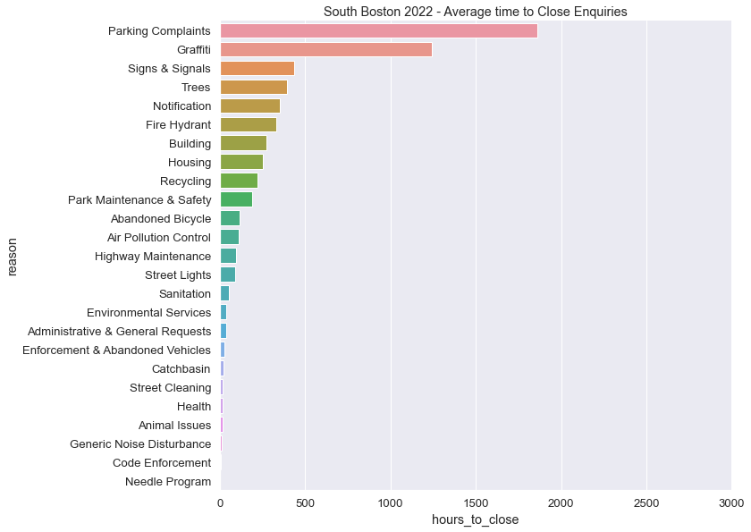
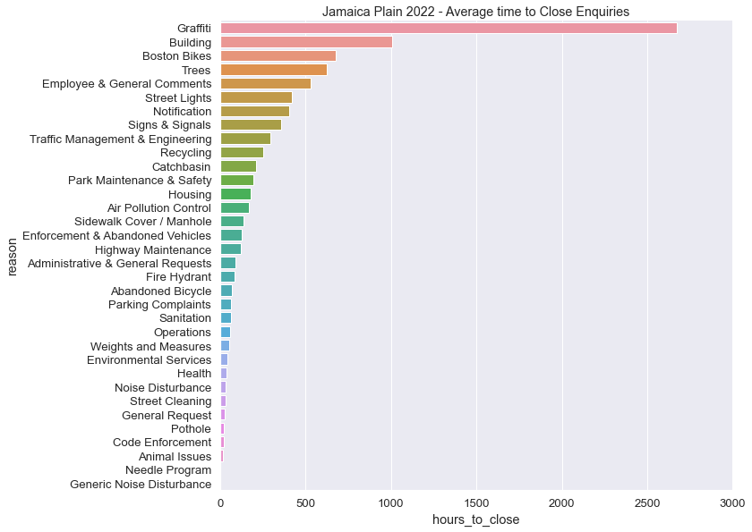
Boston 311 Extension Project Time to Close Enquiries - Shortest vs. Longest Cities
South Boston has the lowest average response time and Jamaica Plain Has the highest
Performed for each city, include each city in final project report

